Slide 1
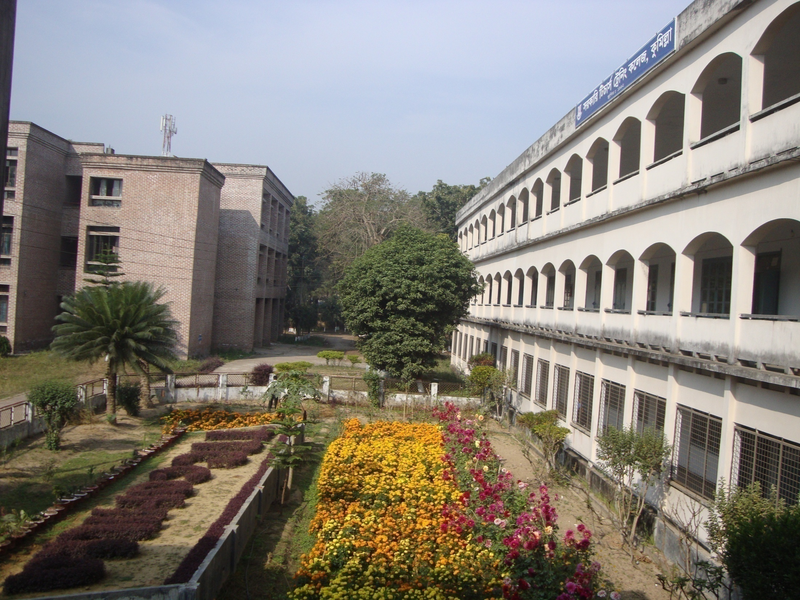

Welcome

Slide 2
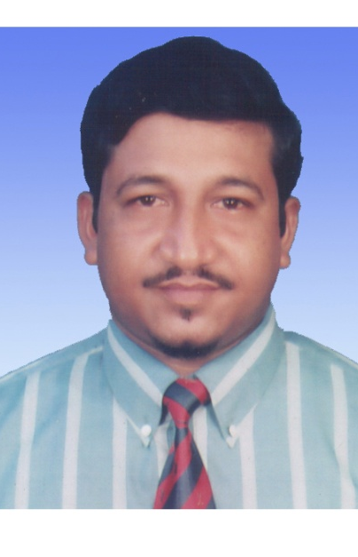
Digital Content for class six
Presented by
Md. Shahidul Islam
Senior Assistant Teacher (English & Computer)
Brahmanbaria Ideal High Academy
Mobile: 01715755939
Email: shahidulislambb@yahoo.com

Slide 3
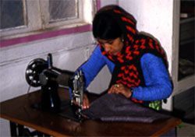
Today’s Lesson
Class six Section - B Students 83 Presences 70
I’m a woman.
I work and make cloths in my house.
Parts of speech

Slide 4
Objectives:
Students will be able to----
----define part of speech and say the name of the different kinds of parts of speech.
----define and identify noun.
---- define and identify verb.

Slide 5
Parts of speech
I
eat
fine
rice.
Work in pair to arrange the words in a speech.
I
eat
fine
rice.

Slide 6
Different Kinds
of Parts of Speech
Individual work: Match the words with their own colour.
Rony is very good. He goes to school regularly but his brother does not go. Alas! He is unlucky.
Parts of Speech
1
2
3
4
5
6
7
8

Slide 7
Different Kinds
of Parts of Speech
Rony
is
very
good.
He
goes
to
school
regularly
but
his
brother
does
not
go.
Alas!
He
is
unlucky.
Parts of Speech
2
Verb
1
Pronoun
3
4
Noun
Adjective
Adverb
5
Preposition
6
Conjunction
7
8
Interjection

Slide 8

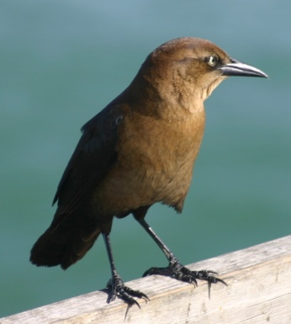
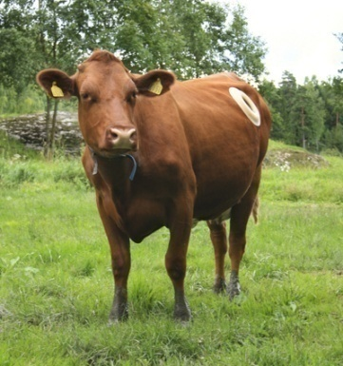
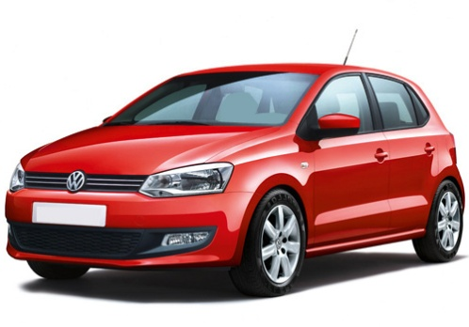
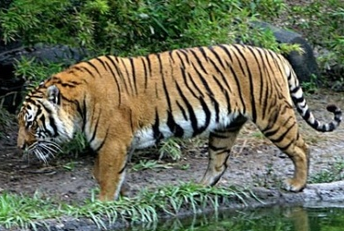
Flower
Bird
Cow
Car
Tiger
Noun

Slide 9
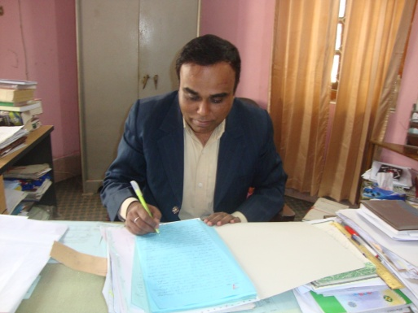
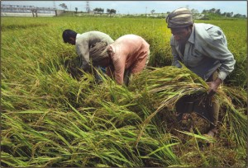
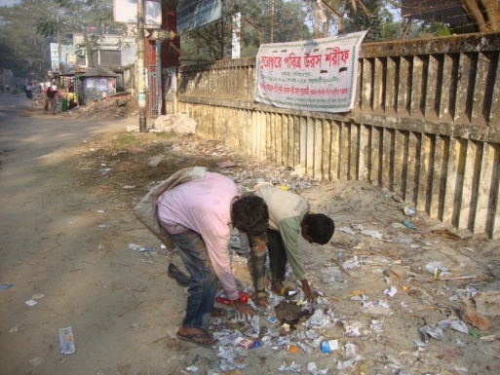
Writing
Cutting
Picking
Working
Write
Cut
Pick
Verb

Slide 10
Home Work:
1. What is part of speech? Write the name of different kinds of parts of speech.
2. What is noun? Write 10 words
regarding it.
3. What is verb? Write 10 verbs
used daily.

Slide 11
ALLAH HAFEZ

